Slide 1

HOP'N Brew
The DMV’s Ultimate Resource for brewery Connoisseurs

Slide 2
HOP'N Brew conception
Hop’n brew was conceived based on our love for beer. The idea was to have an application where one could locate a brewery in the DMV (Washington DC, Maryland, Northern Virginia).
Hop’n brew provides beer aficionados with brewery locations and events throughout the dmv. Utilizing api’s from yelp and google our application provides you with the brewery’s address, website and yelp rating.
Hop’n brew search feature allows you to search the DMV as a whole or by the individual states. YOu may also refine your search by selecting a radius or yelp rating.
We’ve also included an event calendar. Hop’n brew utilizes Eventbrite to gather brewery events and tockify to organize brewery event calendar.

Slide 3



the HOP'N Brew team
GitHub Admin
HTML 5
CSS3
jQuery
Firebase
Tockify
HTML 5
CSS3
Bootstrap 4
Javascript
jQuery
Custom CSS
HTML 5
CSS3
Bootstrap 4
JavaScript
jQuery
Yelp API
Google API

Slide 4
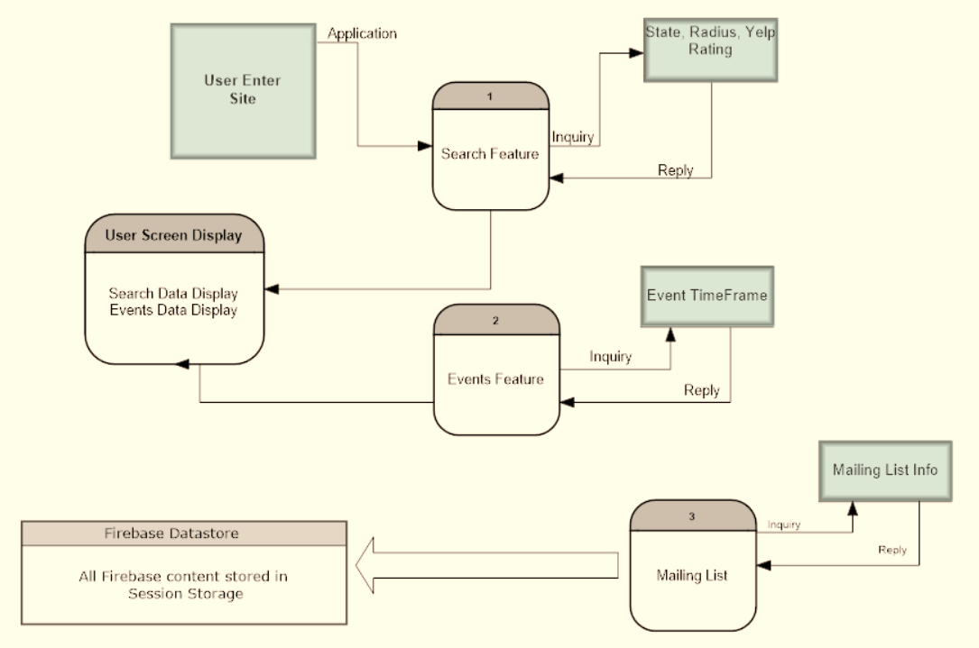
HOP'N Brew’s data flow

Slide 5
HOP'N Brew’s future endeavors
Expand hop’n brew to other cities
Beer recipe feature

Slide 6
Questions?

